Slide 1
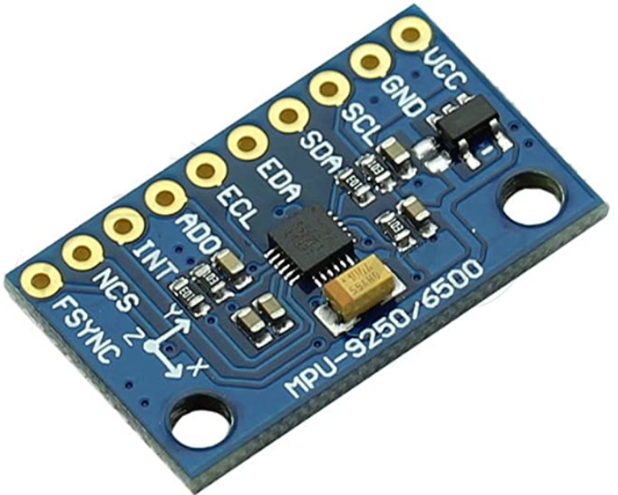
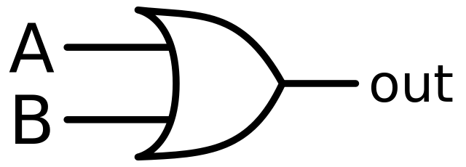
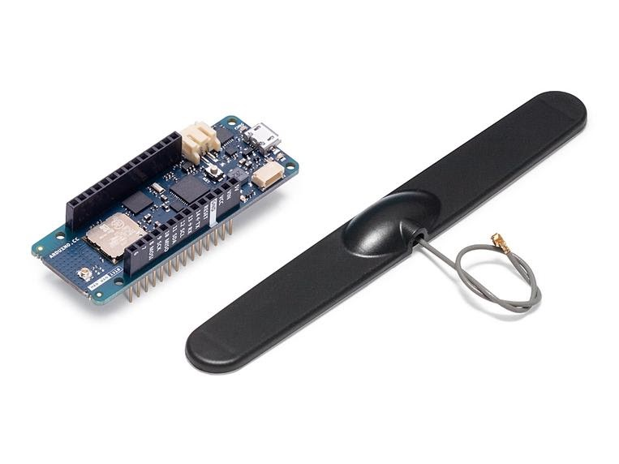
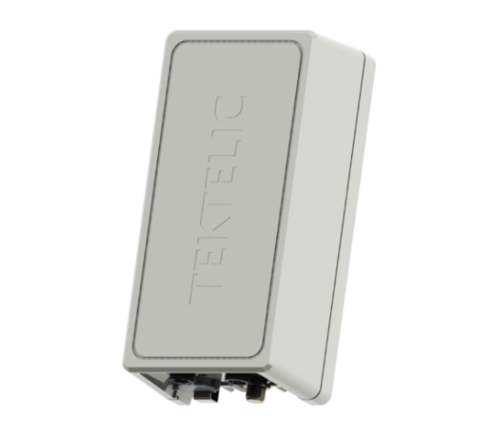

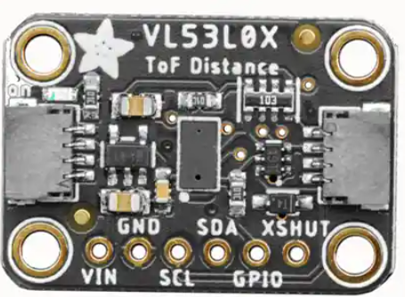
Data Infrastructure
Magnetometer (MPU9250)
LoRa Module (Arduino MKR WAN 1310)
Gateway (Kona Macro)
IoT network
Time of flight (Vl53l0X)
Database
SmartPark Mobile App
REST API

Slide 2
Description:
In the previous slide you can visualize the SmartPark data infrastructure. The data infrastructure is the path the data takes from vehicle detection to the user interfaceable app. The vehicle is detected by two separate sensors where only one true detection equates to a vehicle’s presence. This provides two points of failure for the node. The Arduino LoRa module will then send a Boolean logic to the gateway. The gateway will decrypt the LoRa data and transfer this data to the Chirpstack server. The Chirp stack server is a free LoRa IoT (internet of things) network provided by the LoRa community. From the Chirpstack server the data will be transferred to the database which is provided by Things Board. The data base allows for the data to be transferred to the mobile application. However, the data must first go through a rest API (application programming interface). The API will properly direct data traffic to the SmartPark Mobile application.

